Slide 1

TECHNICAL DOCUMENTATION
GOVERNMENT COLLEGE OF ENGINNERING,YAVATMAL
Presented by:
Nikita Pandurang Bhokare
2nd year(Computer Engineering)
Guide : Prof.Patil Sir

Slide 2
INTRODUCTION
Technical Documentation refers to document that involves product related information and data or the information about any topic ; It holds the detail about a technical product or services that is either under development or already in use.
Simply put ,Technical documentation is all about presenting the product in a way that’s easy to use ,read ,understand and actually help your audience.
Here I have make a project on technical documentation on html language that gives information of html language .This project uses the programming languages that is html and css.

Slide 3
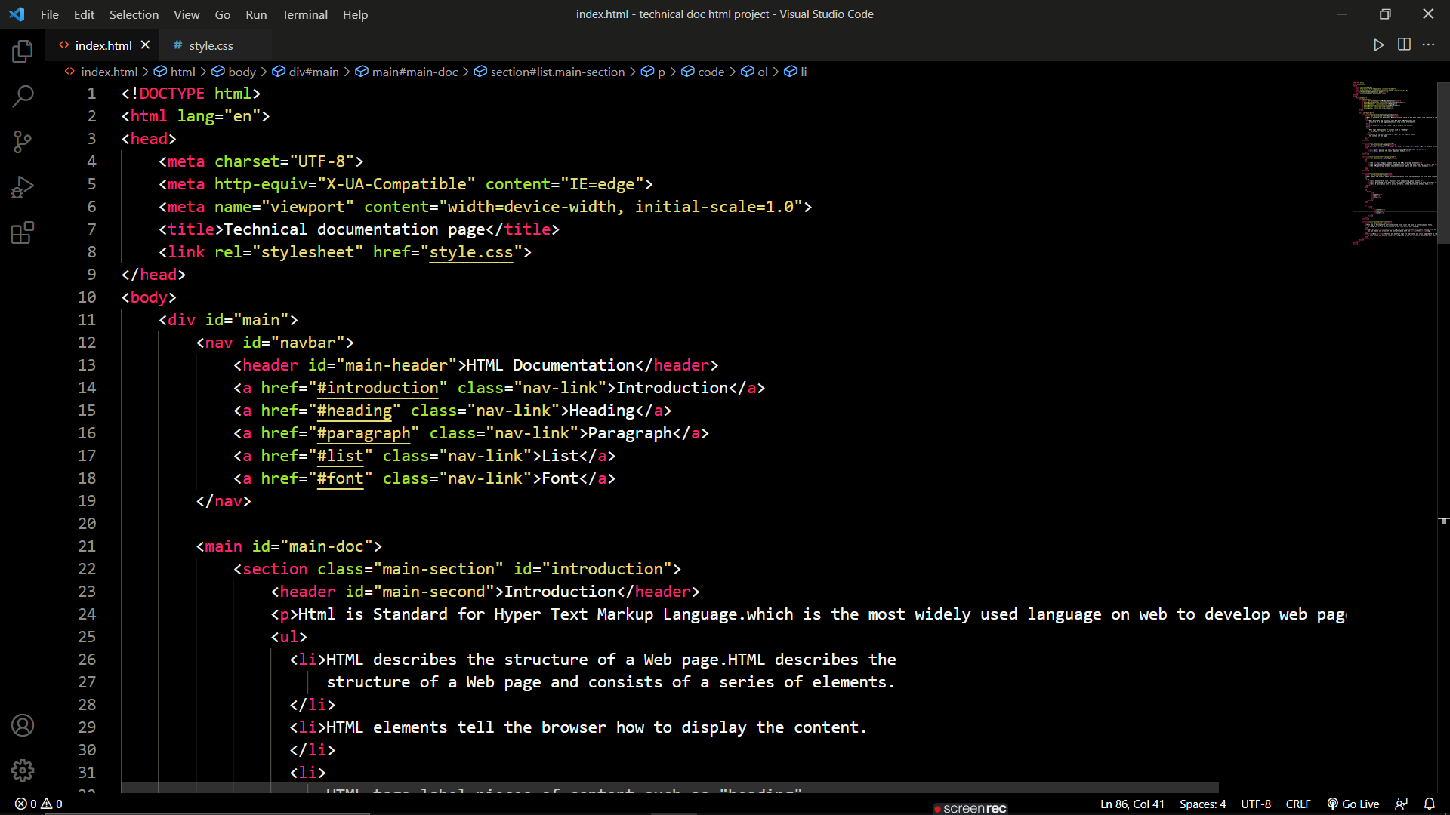
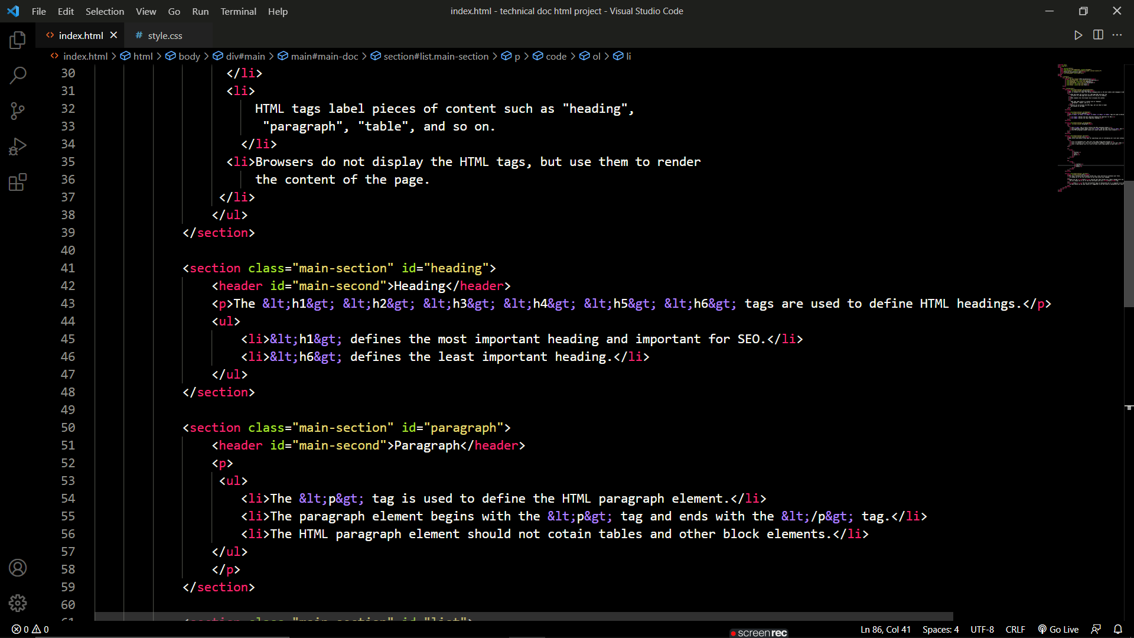
WORKING

Slide 4
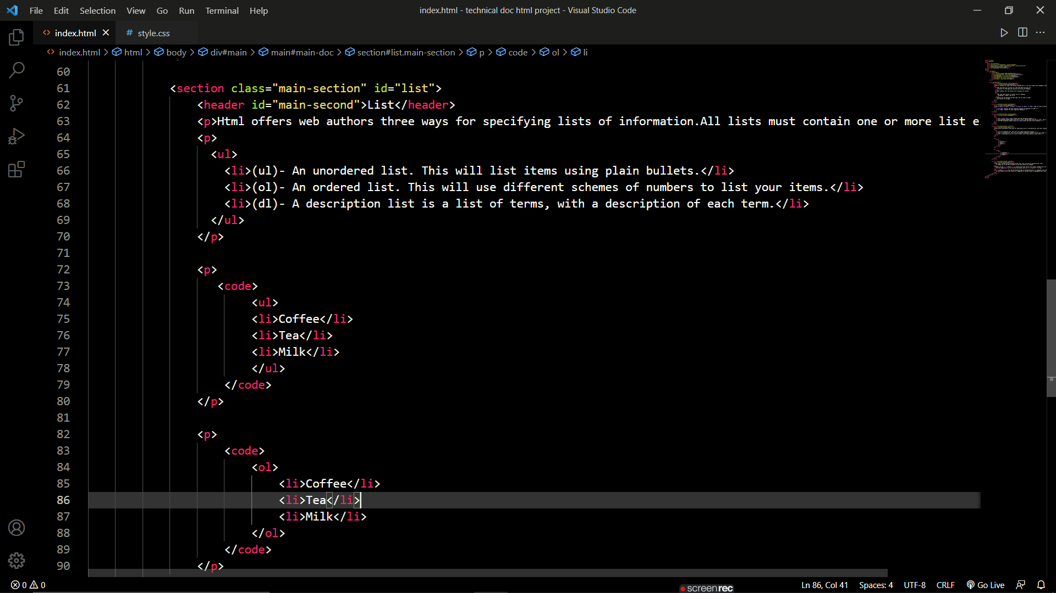
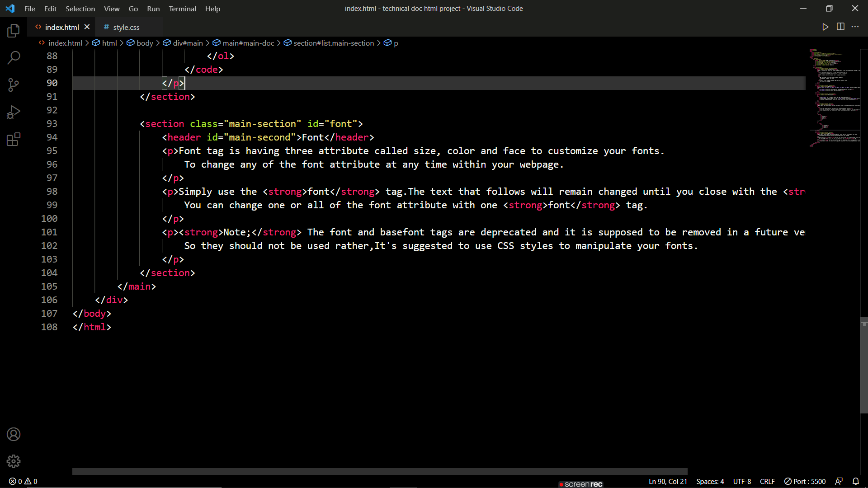

Slide 5
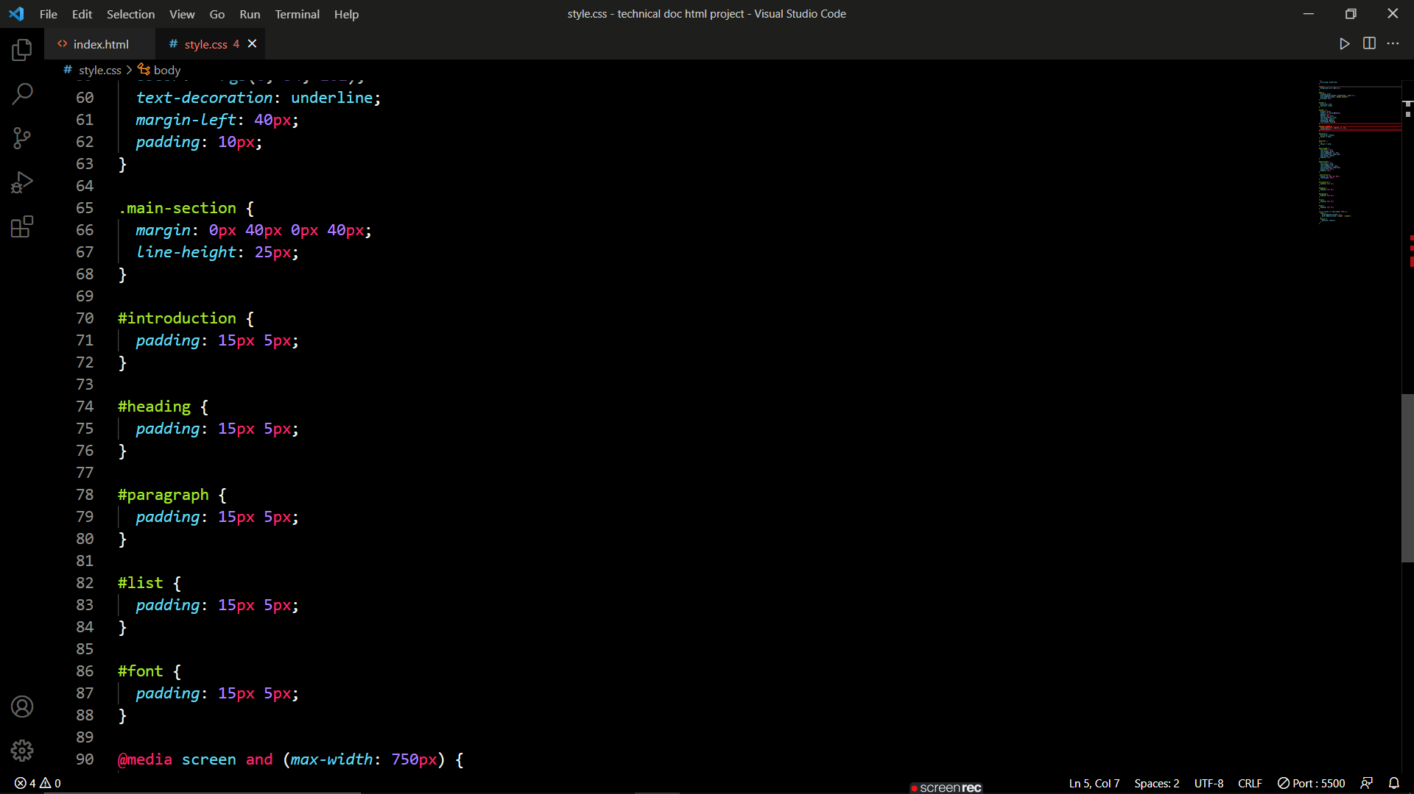
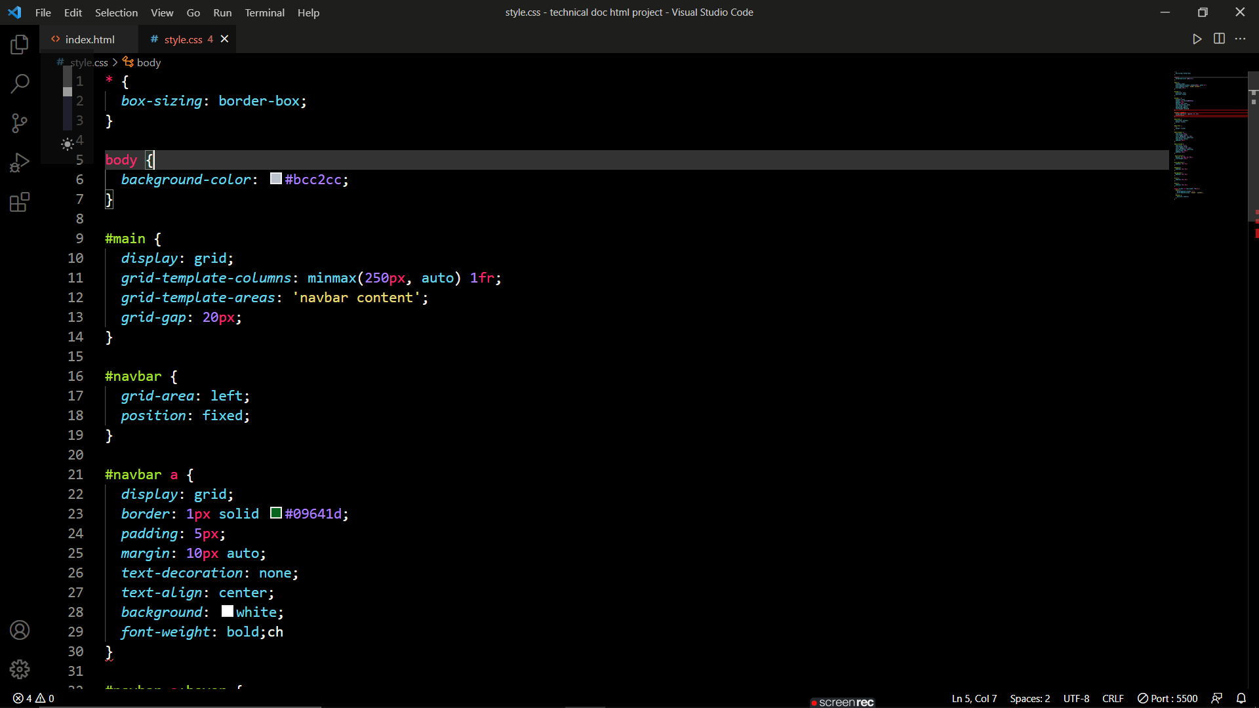
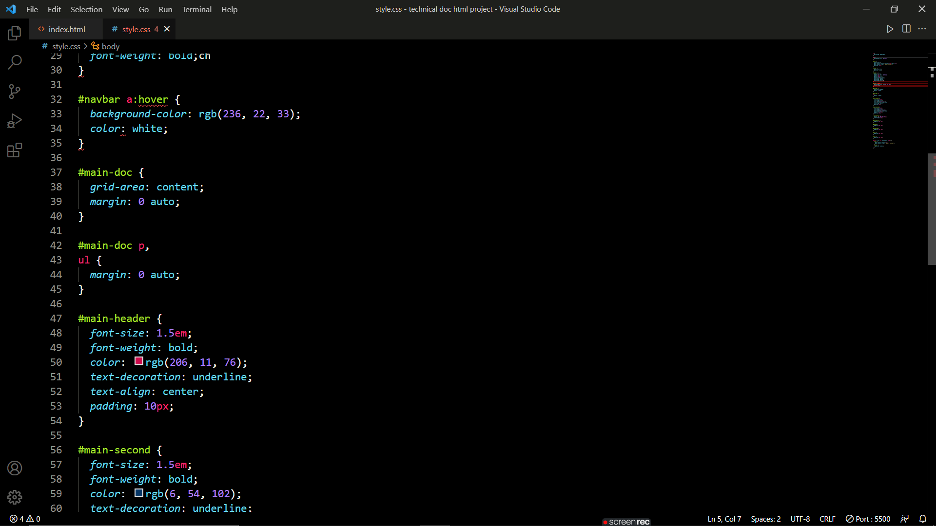

Slide 6
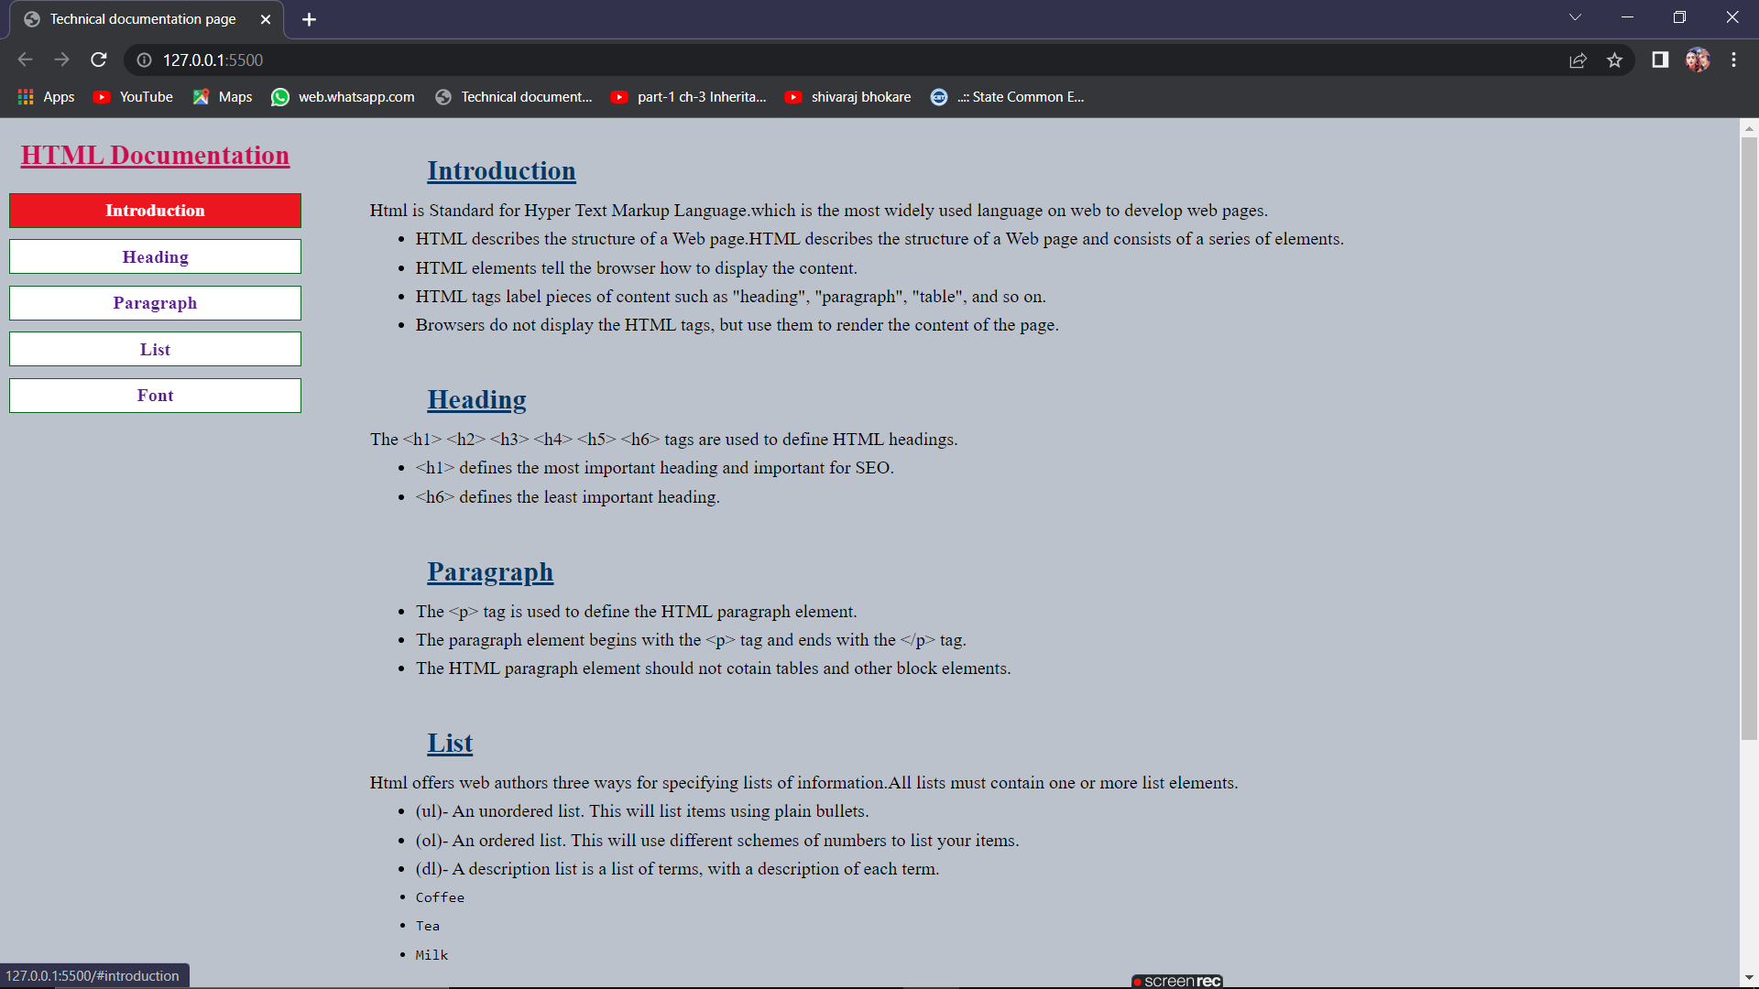
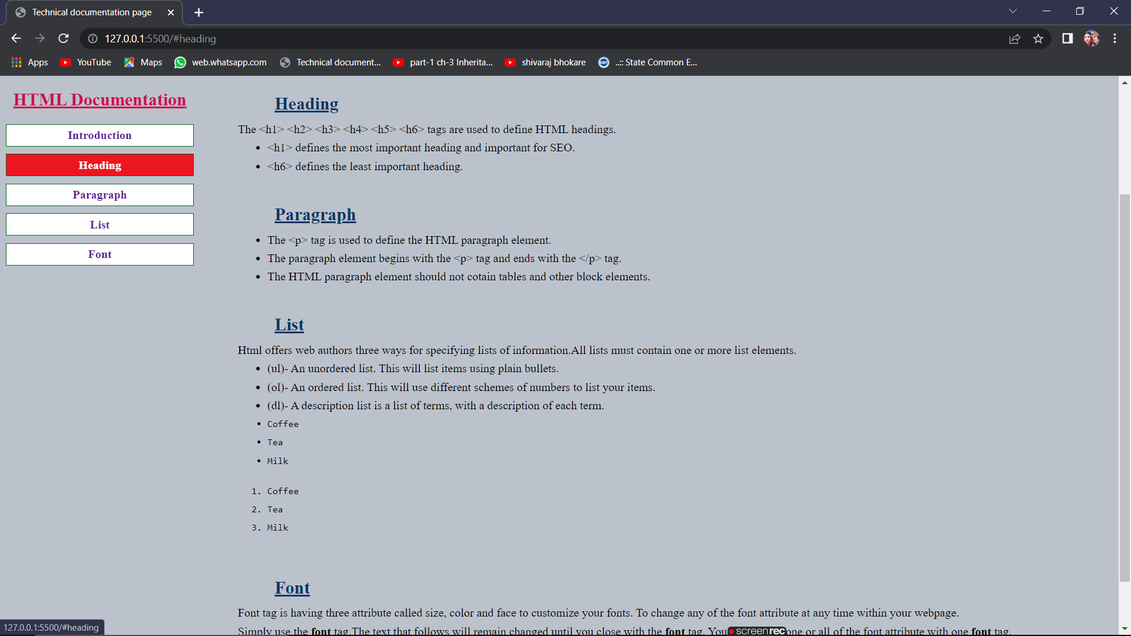
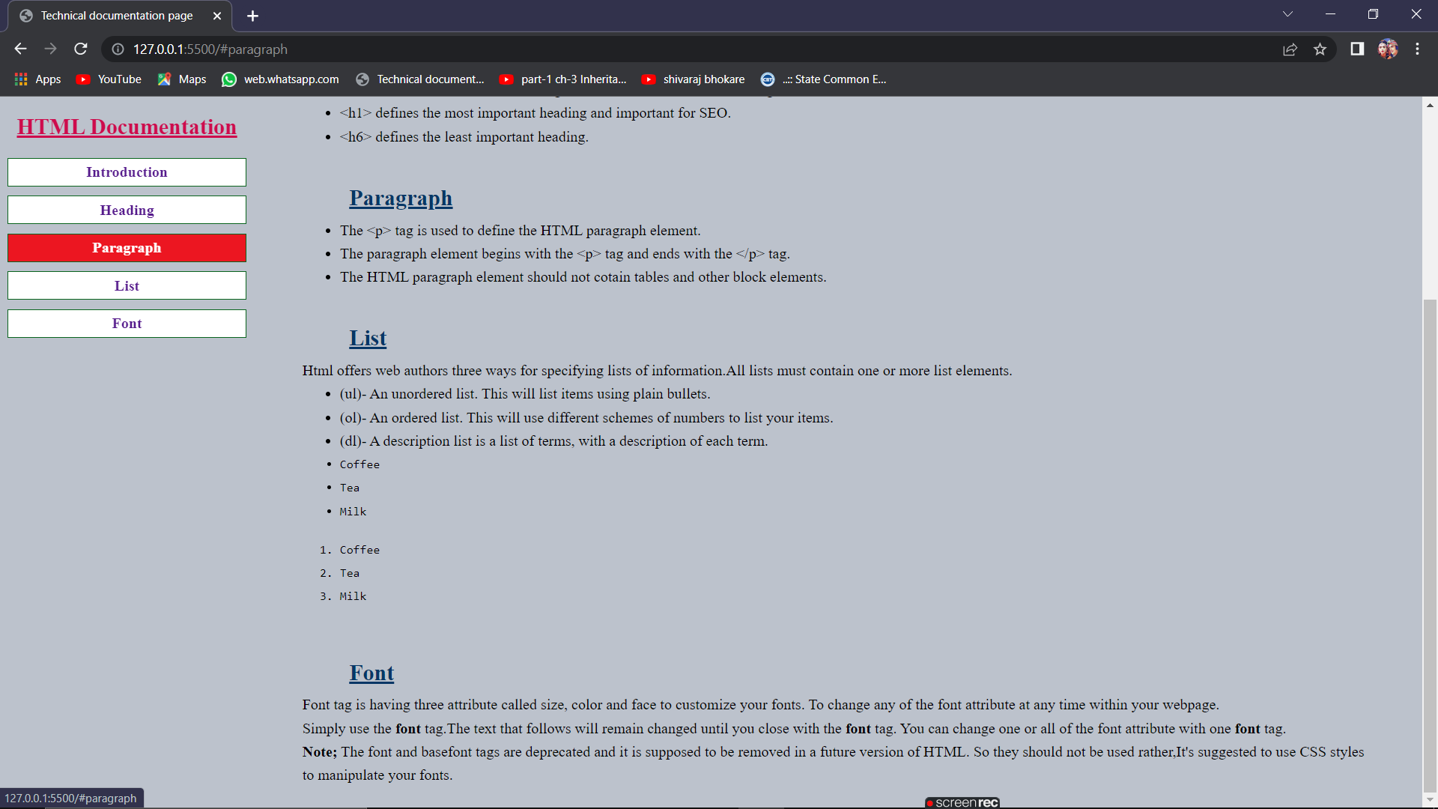

Slide 7
ADVANTAGES
Get more information on the same site.
It becomes easier to resolves issues.
IT helps to make decision easier.
Strong Technical documentation means less support cost and time.
Generate awareness.
It is marketing tool.
Educates users .Here are some of the commonly used content materials to educate users.E.g. Newsletters,presentation,case studies,manuals

Slide 8
LITRATURE REVIEW
For making this website w3schools website helps me a lot. HTML and CSS online tutorials are more informative to learn html and css concept with a examples .
Below given link is the reference of W3school site :
https://www.w3schools.com/html/
After that Bootstrap is one of the Best platform website fast and responsive.It is powerful,extensible,and feature-packed fronted toolkit.
Below given link is the reference of Bootstrap site:
https://getbootstrap.com/

Slide 9
CONCLUSION
I Would like to state that I have described in this project about html language by using technical document.
I have briefy describe here about basics of html language that is introduction, heading ,paragraph ,list ,fonts in html. By using such type of Technical documentation we can describes other subject that is information about product ,marketing Tools ,Newslatter,case studies,manuals etc.
After completing this project I have acquired a lot of knowledge . It was a very pleasant experience for me in making this project…!!

Slide 10
THANK YOU...!!

